Slide 1
Artificial Neural Network (ANN) : Perceptron
Sourav Karmakar
souravkarmakar29@gmail.com

Slide 2
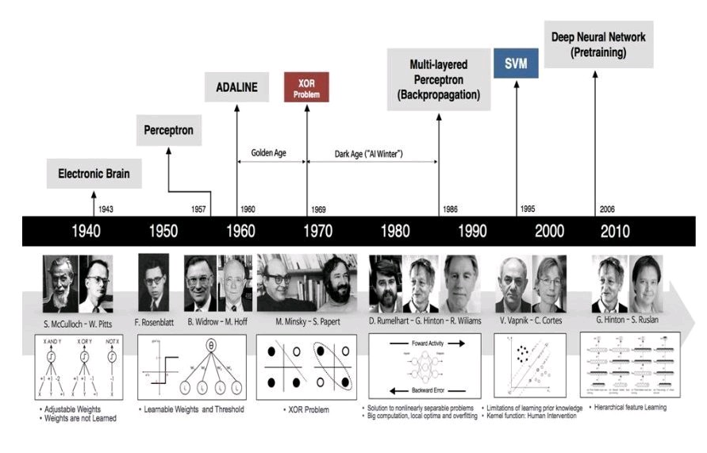
A BRIEF HISTORY

Slide 3
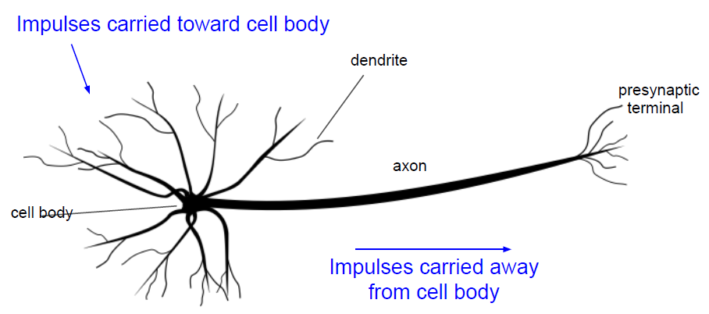
BIOLOGICAL NEURON
Biological Neuron

Slide 4
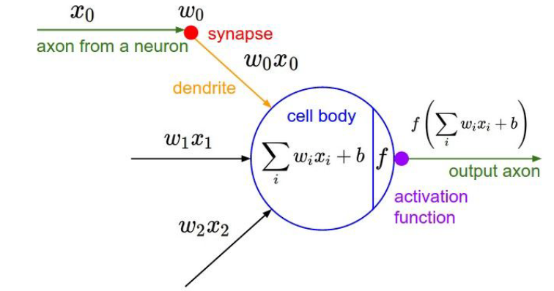
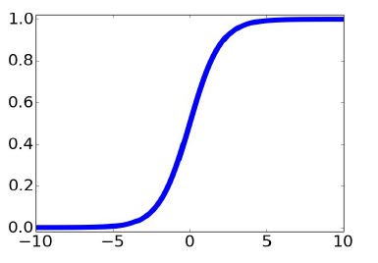

ARTIFICIAL NEURON
$f\left(.\right)$ is called the activation function
For example the activation function could be sigmoid activation function
Artificial Neuron
$b$ is called the bias
$w_{i}$ are called the synaptic weights or simply weights
This is a very crude approximation of biological neuron. Actual biological neuron are even more complex.

Slide 5


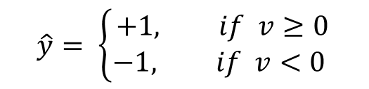
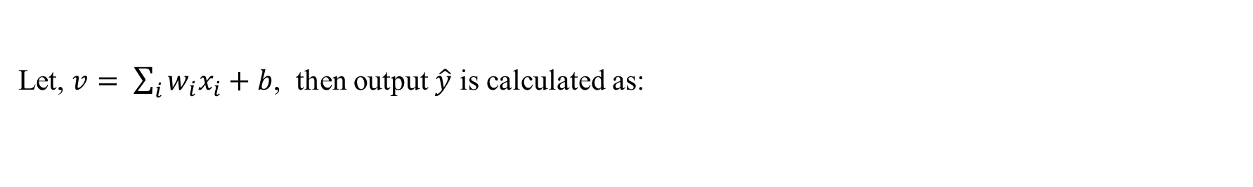


PERCEPTRON
This model of Neuron is also called McCulloch – Pitts Model
Rosenblatt extended this idea and gave a learning rule to update the weight parameters from given dataset. This is called Perceptron.
Activation Function $\left(f\right)$:
$$\hat{y}$$
$$+1$$
In this case the activation function is signum function (sgn)
Let, $v= \sum_{i}{w_{i}x_{i}+b}$, then output $\hat{y}$ is calculated as:
$$v$$
$$\hat{y}= \left\{\begin{matrix}+1, if v≥0 \\ −1, if v<0 \end{matrix}\right.$$
$$−1$$
This is also called hard limiter

Slide 6

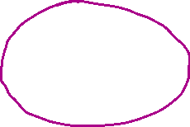
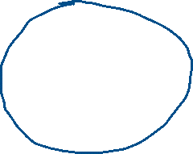






Slide 7
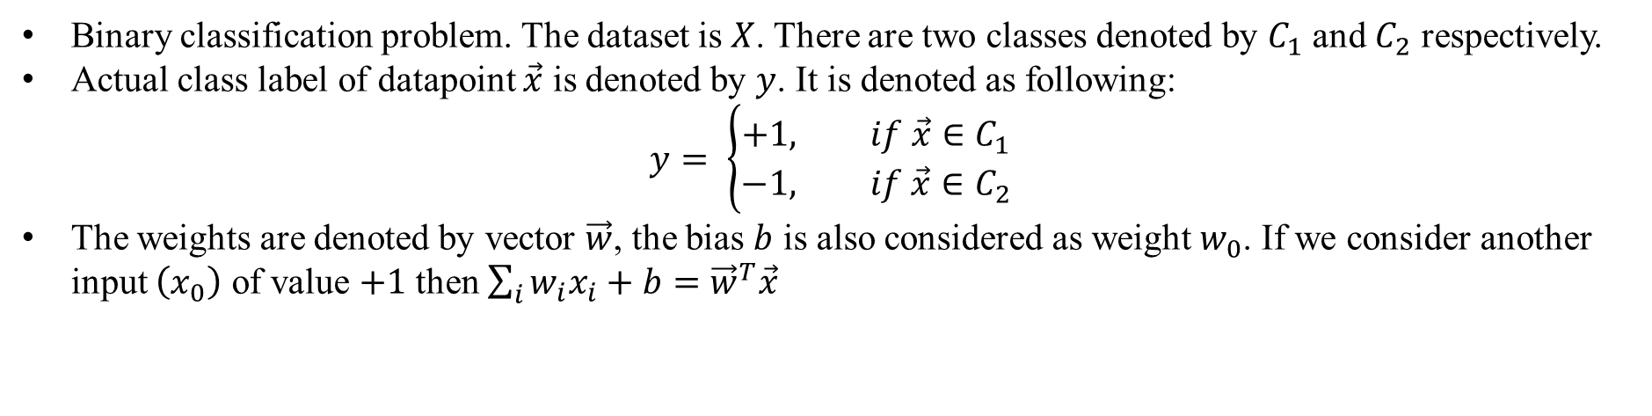

PERCEPTRON LEARNING RULE
Assumptions:
Binary classification problem. The dataset is $X$. There are two classes denoted by $C_{1}$ and $C_{2}$ respectively.
Actual class label of datapoint $\vec{x}$ is denoted by $y$. It is denoted as following:
$$y= \left\{\begin{matrix}+1, if \vec{x}∈C_{1} \\ −1, if \vec{x}∈C_{2}\end{matrix}\right.$$
The weights are denoted by vector $\vec{w}$, the bias $b$ is also considered as weight $w_{0}$. If we consider another input $\left(x_{0}\right)$ of value $+1$ then $\sum_{i}{w_{i}x_{i}+b={\vec{w}}^{T}\vec{x}}$
Algorithm:
Initialize: Initialize the weight vector $\vec{w}\left(0\right)$ with some small random numbers. Iteration count $t←1$
Repeat
for $\vec{x}∈X$, Compute $\hat{y}=\operatorname{sgn}\left({\vec{w}}^{T}\vec{x}\right)$ , $\hat{y}$ is the computed output / label.
$\vec{w}\left(t+1\right)=\vec{w}\left(t\right)+η \left(y −\hat{y}\right) \vec{x}$ , $y$ is the actual output / label. (from labelled training data)
Until $\left|\left|\vec{w}\left(t+1\right) − \vec{w}\left(t\right)\right|\right|<ε$ , $ε$ is the user defined tolerance [check of convergence]
$η$ is called the learning rate.
If not converged then $t ←t+1$ and repeat the whole process.

Slide 8
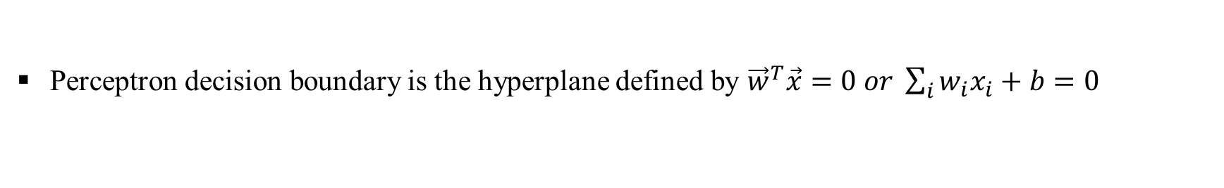


PERCEPTRON DECISION BOUNDARY
Perceptron decision boundary is the hyperplane defined by ${\vec{w}}^{T}\vec{x}=0 or \sum_{i}{w_{i}x_{i}+b=0}$
$$X_{2}$$
Consider a binary classification problem. Dataset is shown in the figure beside.
Random initialization of weight vector at the starting of the learning algorithm randomly fits a hyperplane (straight line in 2D) as shown beside.
As we keep updating weights using the learning rule, the decision boundary keeps on changing.
Till all the training datapoints fall correctly in the either side of the decision boundary.
Class-1
Class-2
Thus perceptron acts as a linear classifier and can classify linearly separable data with high accuracy.
$$X_{1}$$

Slide 9
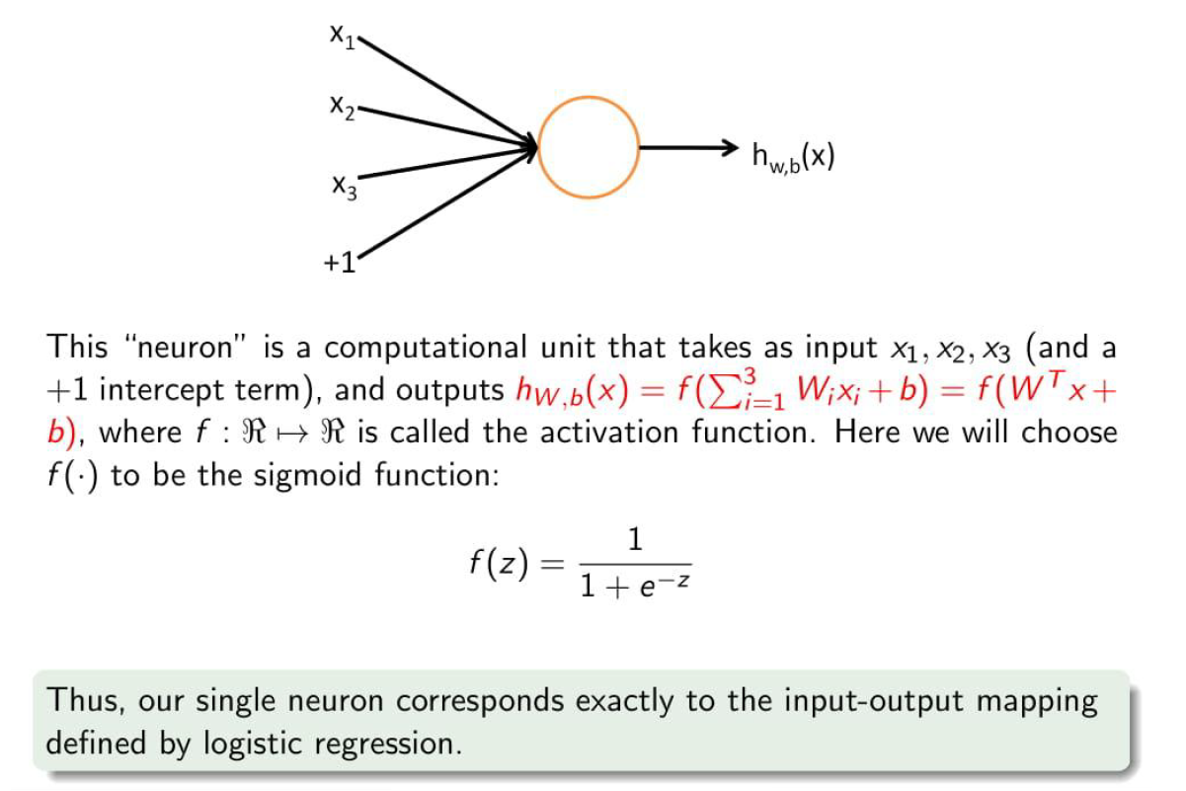
PERCEPTRON WITH SIGMOID ACTIVATION

Slide 10
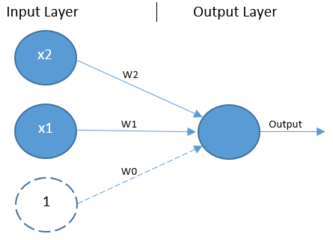
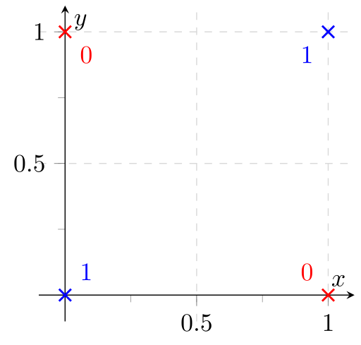
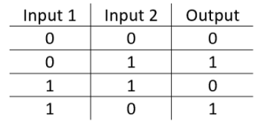
LIMITATIONS OF PERCEPTRON
XOR Problem:
Though perceptron works well for linearly separable dataset.
It failed to solve XOR problem and other non-linear datasets. Because there is no straight line that can form the decision boundary between the two classes.

Slide 11
Thank You

